Slide 1
Analysis of an Electronic Voting System
Alaa Sayed Ahmed Hussein
201003410
Notes:
Published in 2004
Cited 544 times

Slide 2
Outline
Introduction
System Overview
Smartcards
Election Configuration & Election Data
Software Engineering
Conclusion

Slide 3
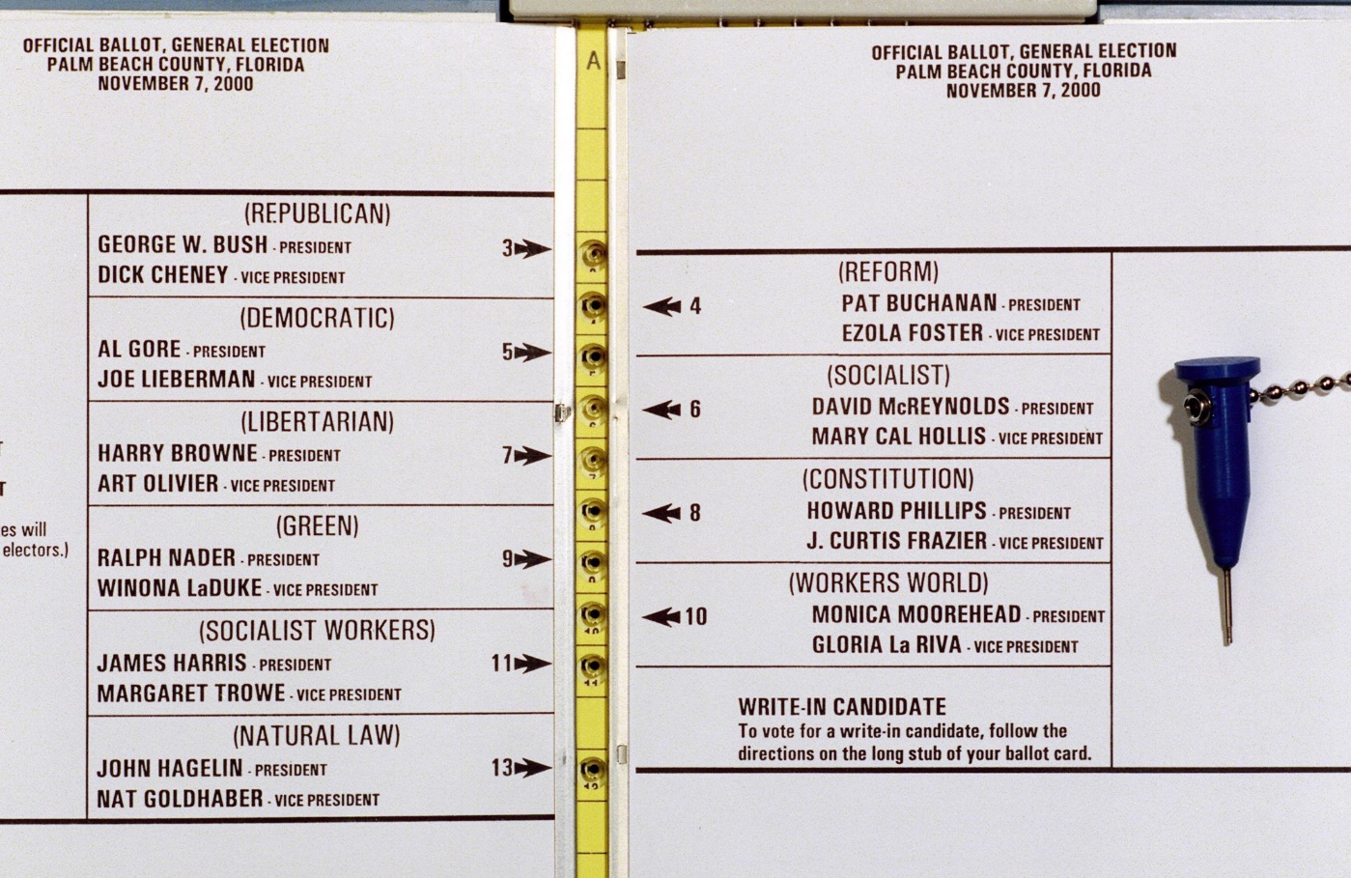
Introduction
Voting systems must be:
Anonymous
Tamper-resistant
User-friendly
Notes:
To obtain real reflecting results, a voting system must be robust, transparent and comprehensible.
Anonymous: we should not know which voter voted to which candidate
Tamper-resistant: adversaries can not modify the system & results
User-friendly: easy to use to avoid misvoting
There was a case in 2000 in Florida where it wasn’t clear which punch hole belongs to which candidate.

Slide 4
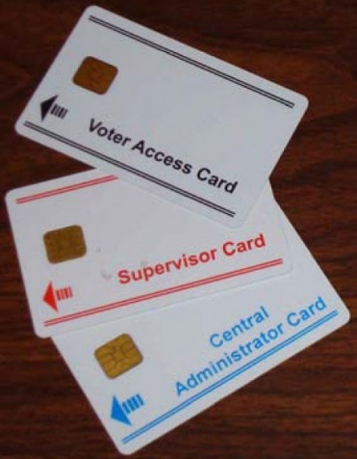
System Overview: AccuVote-TS 4.3.1
Set Up:
Preparing data, voting terminals & distributing ballot definitions to voting terminals
Election
Voter must have a card
Card is cancelled after voting
Results
Poll worker ends election process
Results are written to storage unit & transmitted to back-end server
Notes:
Preparing data (ballot definition): candidates, party affiliation…etc.
Preparing voting terminals: configuring & installing terminals on voting places
Distributing ballot definitions to voting terminals: and that is done using removable media, local network,…etc.

Slide 5
Smartcards - Homebrew Smartcards
Cryptographic operations are not performed → no secure authentication of the smartcard
Attackers can use their own smartcards to vote
User-programmable smartcards and smartcard readers are commercially available
Implementing cards that speak the same protocol
Notes:
Upon reviewing the Diebold code, we observed that the smartcards do not perform any cryptographic operations.
Because of a lack of cryptography, there is no secure authentication of the smartcard to the voting terminal.
This means that nothing prevents an attacker from using his or her own homebrew smartcard in a voting terminal. user-programmable smartcards and smartcard readers are available commercially over the Internet in small quantities and at reasonable prices. attacker who knows the protocol spoken between voting terminals and legitimate smartcards could easily implement a homebrew card that speaks the same protocol.

Slide 6
Smartcards - Multiple Votes
Bring multiple active homebrew cards
Program smartcard to ignore terminal deactivation command
Is it detectable?
Total # votes vs. # voters
Not detectable
Voter serial number is stored only in case of cancelled votes. So it counts non-voters
Notes:
The only per-voter information is a “voter serial number”, only recorded by the voting terminal if the voter decides not to place a vote
It can be easily detected by comparing total #votes to #voters, however, only if polling locations keep accurate counts of the number of people who show up to vote.
But they don't

Slide 7
Smartcards - Admin & worker functionalities
Admin cards allow holder to access administrative functionalities.
Ender card & admin card allow holder to end election process
Adversary can create his/her own admin or ender card
Has knowledge of code
Can interact with admin or ender card
Adversary ending the election process = denial-of-service attack
Notes:
We have 3 types of cards:
Voter card: to vote
Administrator card: admin tasks & ending process
Ender card: only to end process

Slide 8
Election Configuration & Election Data
Attack Vectors:
Physical access to data storage
Windows CE mounts removable storage as subdirectories
System checks for storage cards by looking for subdirectory “Storage Card”
This could cause data loss
Man-in-the-middle attack to the network
Connected via Internet, local network or dial-up connection
Notes:
Accessing & attacking voting system’s data via:
Physical access to data storage
Two types of memory:
main: OS, system configuration information…etc.
removable: to store votes
Windows CE mounts removable storage as subdirectories. System checks for storage cards by looking for subdirectory “Storage Card”. If a directory has the same name in the main storage area (that contains terminal’s OS, program executables, system configuration information), system could store data there and data is lost.
Man-in-the-middle attack to the network

Slide 9
Election Configuration & Data (cont.)
Tampering with the system configuration
Adversary can change terminal’s ID to impersonate another terminal
Handling this issue is not clear
“Protective Counter” is stored in a mutable file
Requires tamper-resistant hardware token
Tampering with ballot definitions
Ballot definition is neither encrypted nor checksummed
Adversary can tamper the definition files before downloading
Notes:
Configuration information are stored in a windows registry as plaintext. Adversary can modify the registry to impersonate other terminal. It is not clear how the system deals with votes from terminals with the same id.
Adversary can modify this counter to cause chaos upon election results. Securing this counter with a checksum is not very secure. Hardware token would require physical modification to existing hardware.
Ballot definition for each election (election.edb) contains everything from the background color of the screen and information about the candidates and issues on the ballot to the PPP username and password to use when reporting the results, if reporting the results over a dial-up connection. This data is neither encrypted nor checksummed.
Adversary can tamper the definition files before downloading them at the voting terminals. They can change candidates’ names, order of appearance…etc

Slide 10

Election Configuration & Data (cont.)
Impersonating legitimate voting terminals
Ballot definition files contain enough info for adversary to impersonate
Key management and other cryptographic issues
Data on storage device is encrypted with a single, hardcoded DES key.
Used since December 1998!
DES is not reliably secure
CBC’s IV is just zero
Notes:
Ballot definition files contain enough information such as voting center ID, username, password, IP of back-end server that make it easy for an adversary to impersonate a genuine voting terminal.
vote records and the audit logs are encrypted and checksummed before being written to the storage device. However, they are encrypted with 1 hardcoded DES key. And it has been used since 1998!
Another problem is that they use DES, that can be exploited by brute force in a short period of time. Also, DES is used in CBC mode, that requires an initial vector. And they are always just using zero….

Slide 11
Software Engineering
It uses an “unsafe” language – C++
Use Java or Cyclone
Complex & undocumented code
Developers & security evaluators are unable to assess properly
No documentation of how system works
Use of third-party code & operating systems
Notes:
system is implemented in an unsafe language, but developers seemed to avoid buffer overflows.
Another thing is that there is some complex code that is not documented. This would make it difficult for internal developers & external security evaluators to assess system properly.
They also did not find any documentation of how the system functions, from interface to algorithms.
Lastly, their use of 3rd party code & OS increases the possibility of vulnerabilities presence

Slide 12
Conclusion
Diebold’s AccuVote-TS 4.3.1 security is just… bad
Multiple votes
Administrative function access
Insider threat
Low quality control
Notes:
Voters can vote multiple times and not be detected
Regular voters can access admin functions
Insiders such is poll worker, software developers impose an insider threat
Based on development environment, they had a low quality control over the system

